Slide 1
Little Endian 2.0
Floris Boers, timo Lamberts, Gjalt van der Meer,
Jayden van Oorschot, Silvester Rademakers, Ilias Takassa
12-06-2024
Notes:
Jayden

Slide 2
Inhoudsopgave
Epics, Sub - Epics en User Stories
Assembly
Hoofd
Code blocks
Communication
Buttons
Vragen
Notes:
Jayden

Slide 3
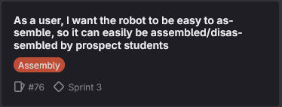
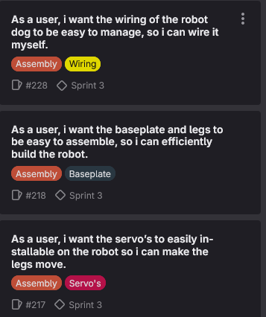
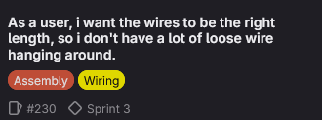
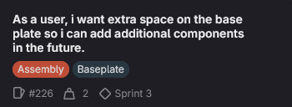
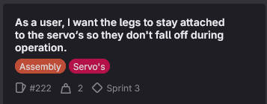
Epics: Assembly
Epic:
Sub-epic:
User stories:
Notes:
Silvester

Slide 4
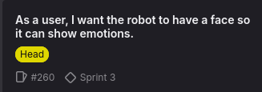
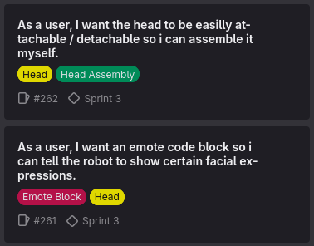
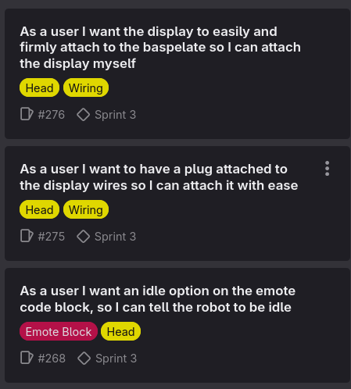
Epic: Hoofd
Epic: Sub epic: User stories:
Matrix(€4) of oled(€7)?
Notes:
Timo

Slide 5
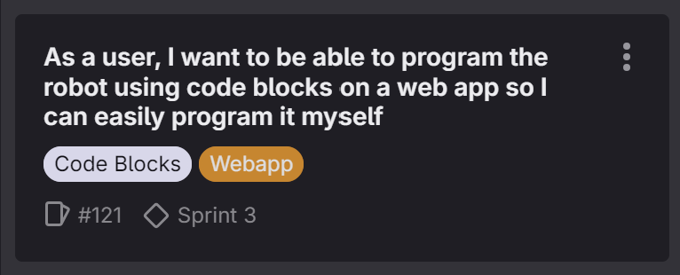
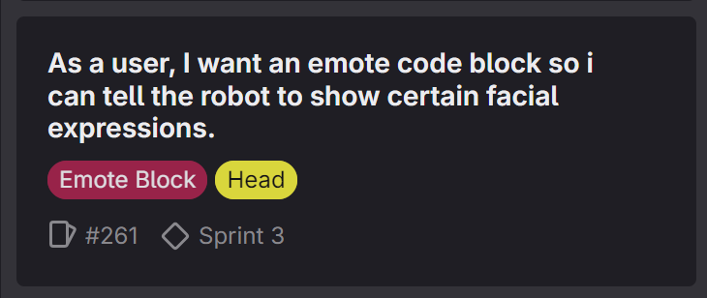
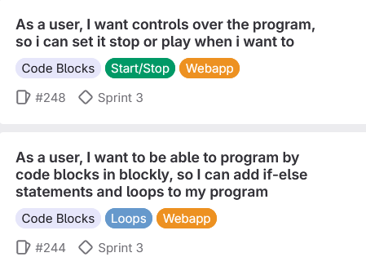
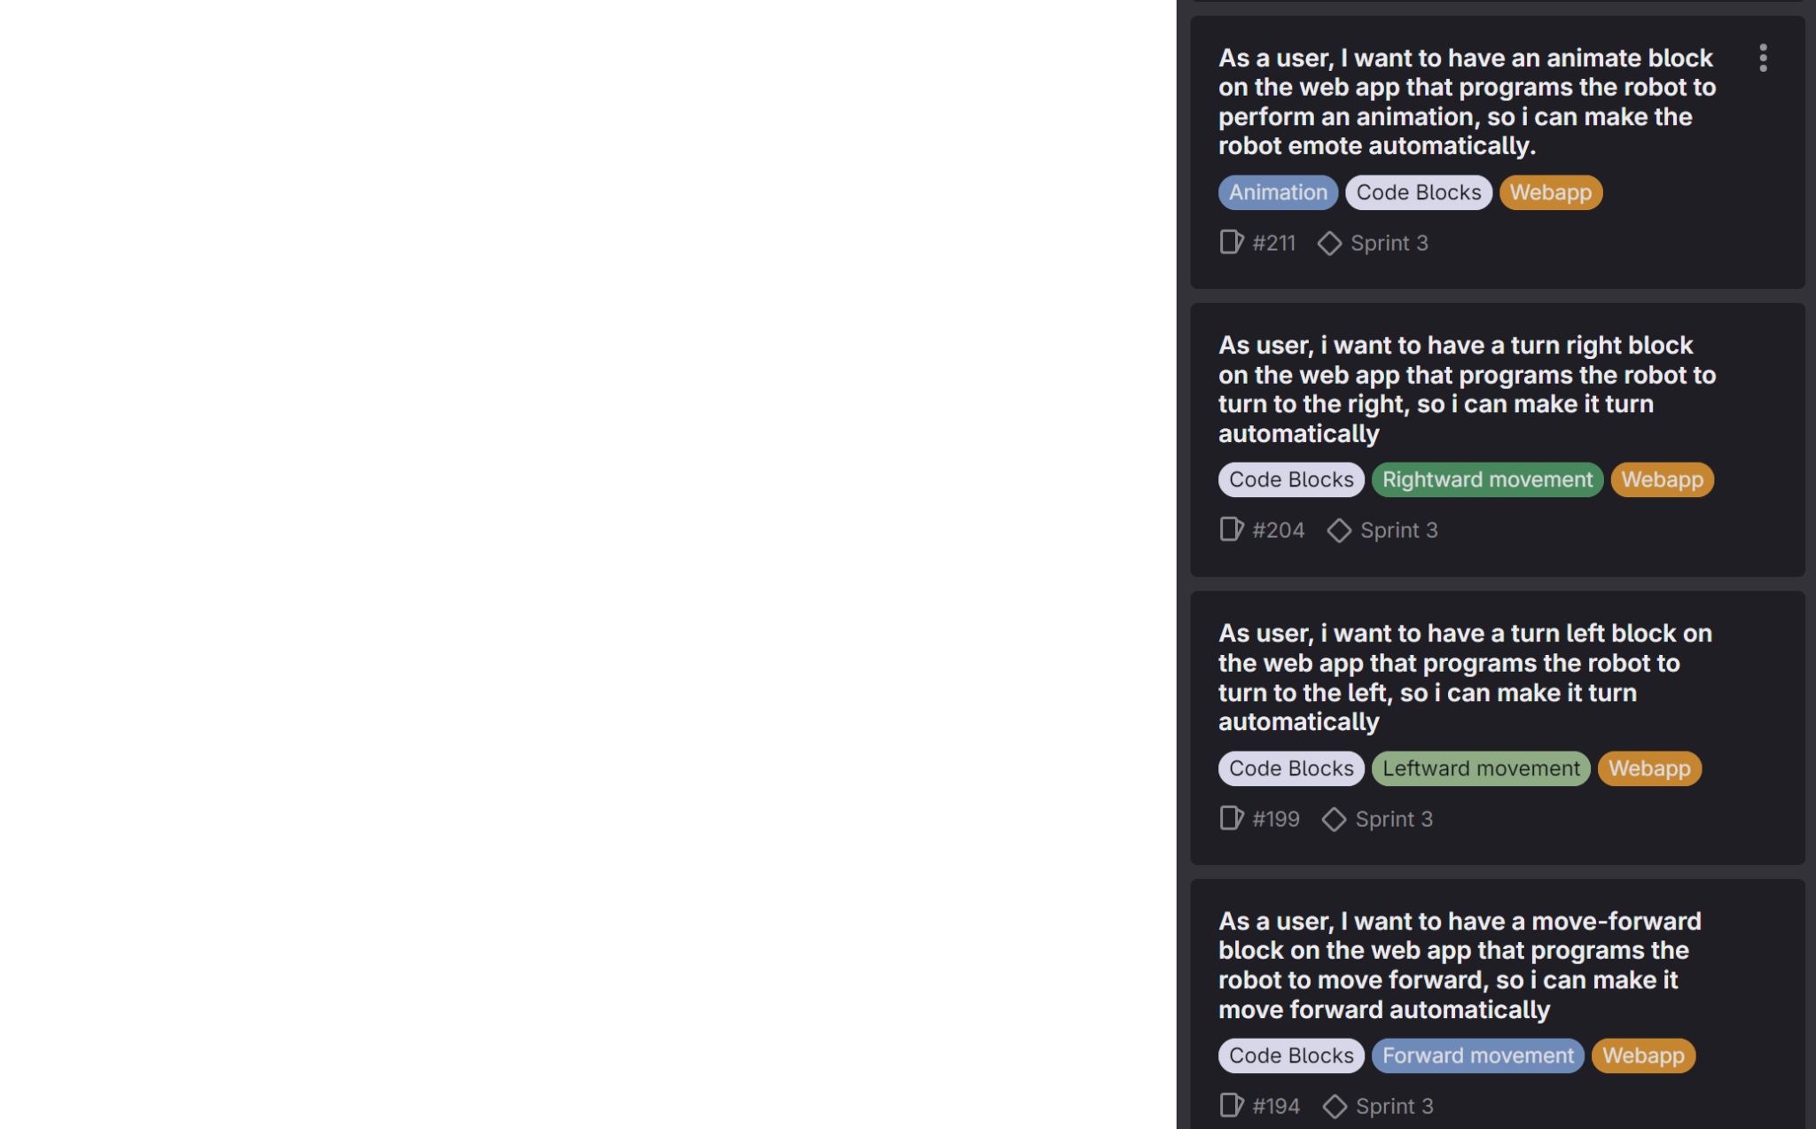
Epic: Code Blocks
Epic:
Sub - epic:
User stories:
Notes:
Floris

Slide 6
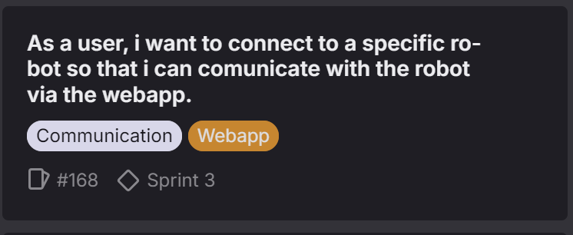
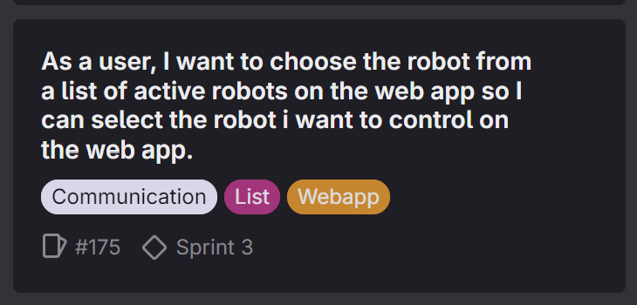
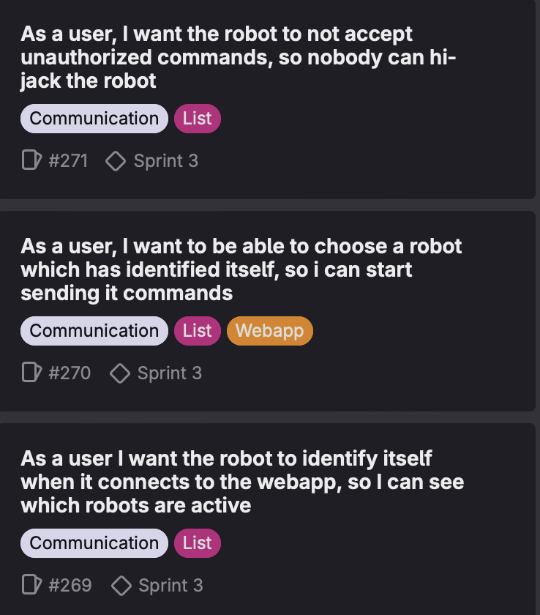
Epic: Communication
Epic:
Sub - Epic:
User stories:
Notes:
Ilias

Slide 7
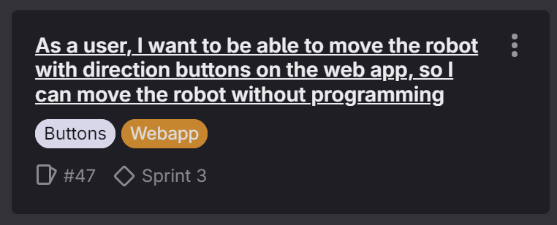
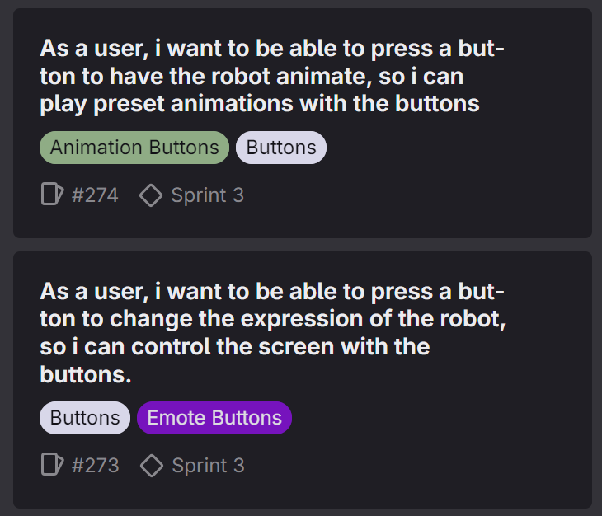
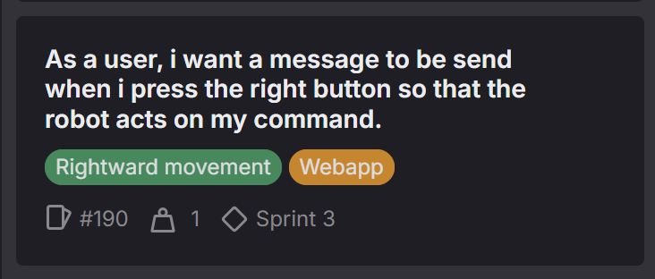
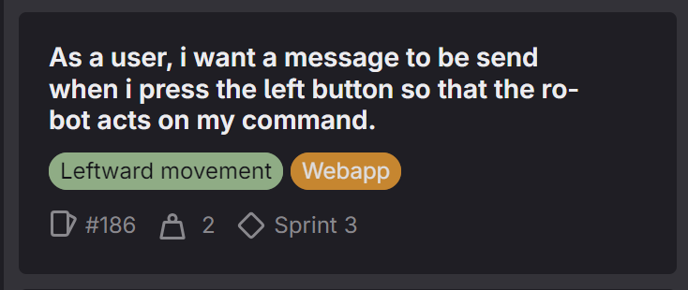
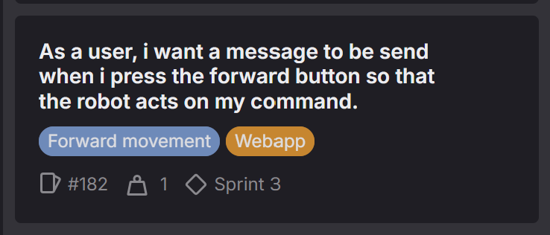
Epic: Buttons
Epic:
Sub - epic:
User stories:
Notes:
Gjalt

Slide 8
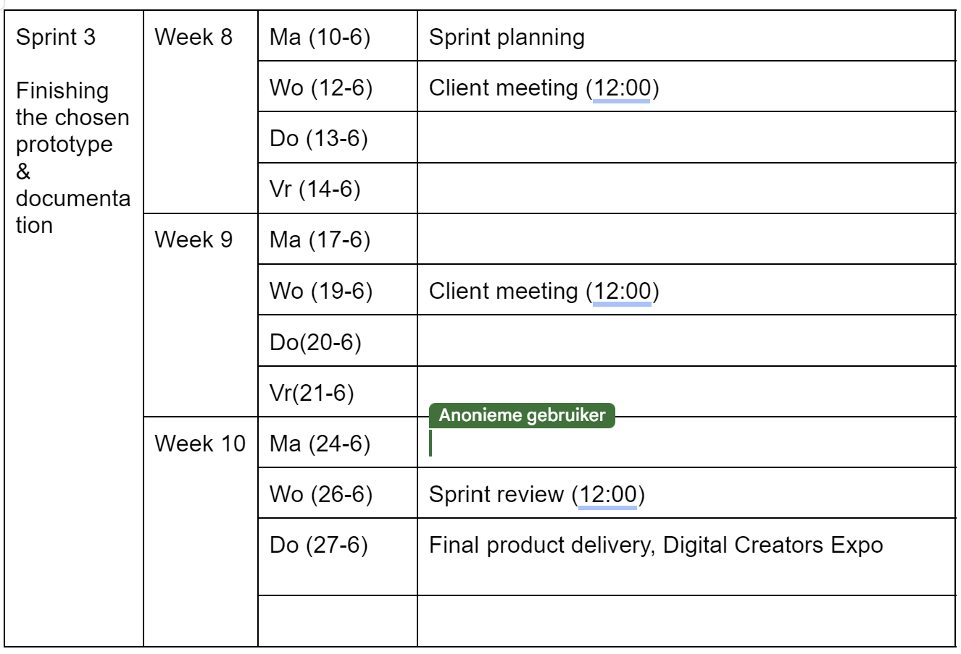
Sprint 3: Planning
Nieuwe rollen

Slide 9
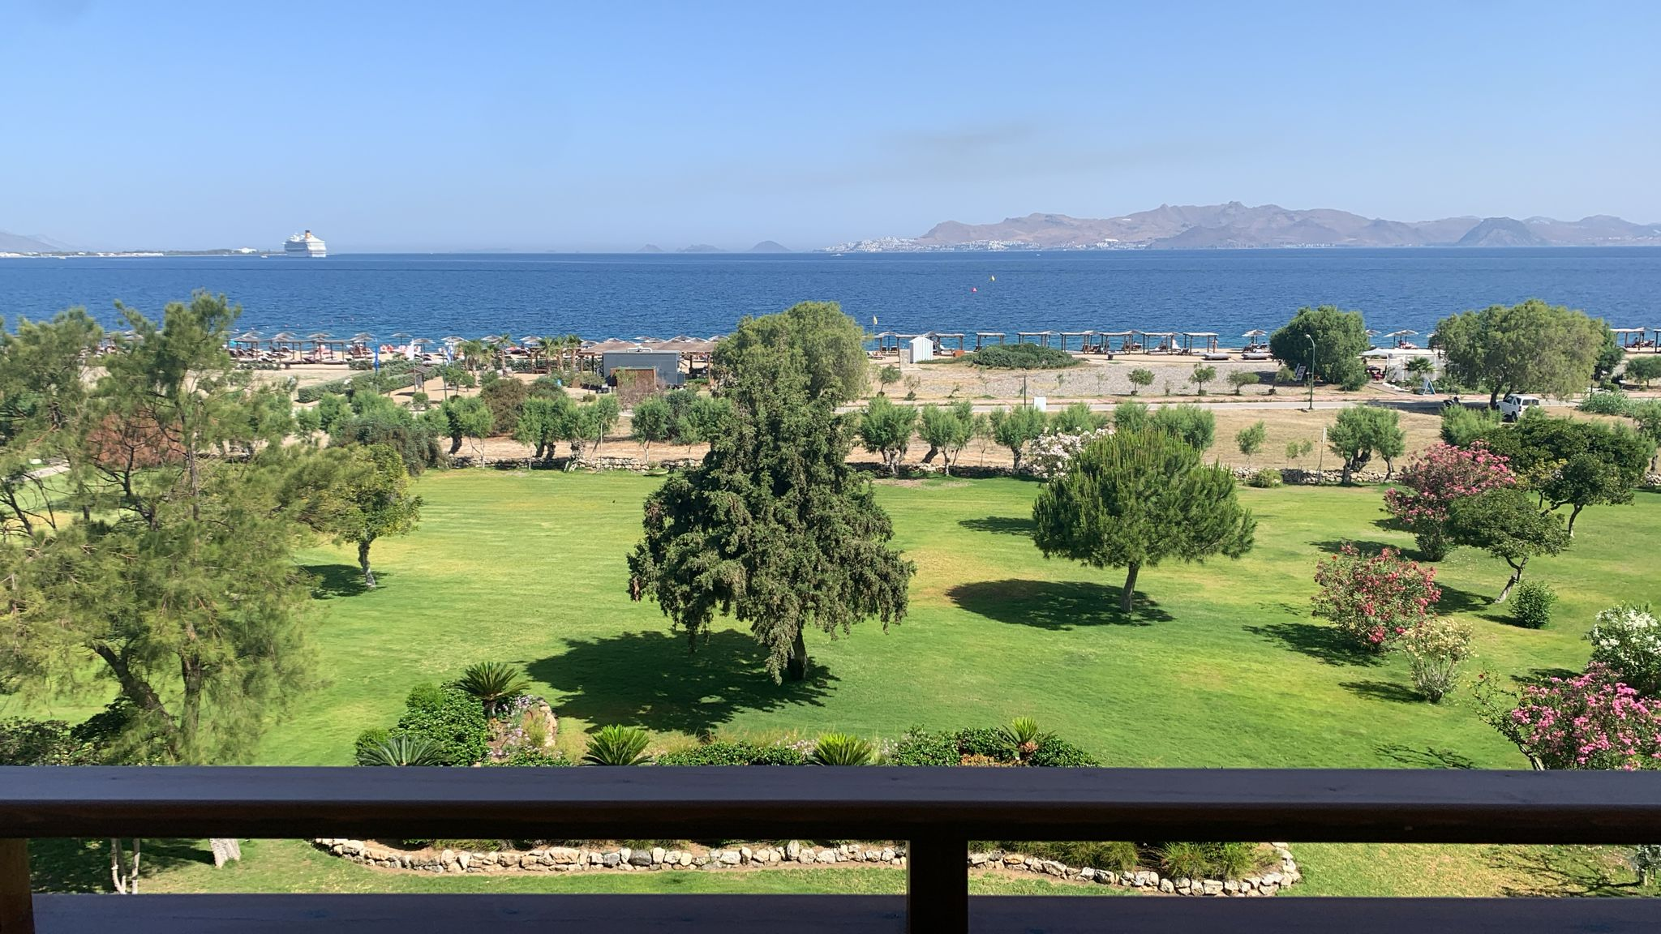
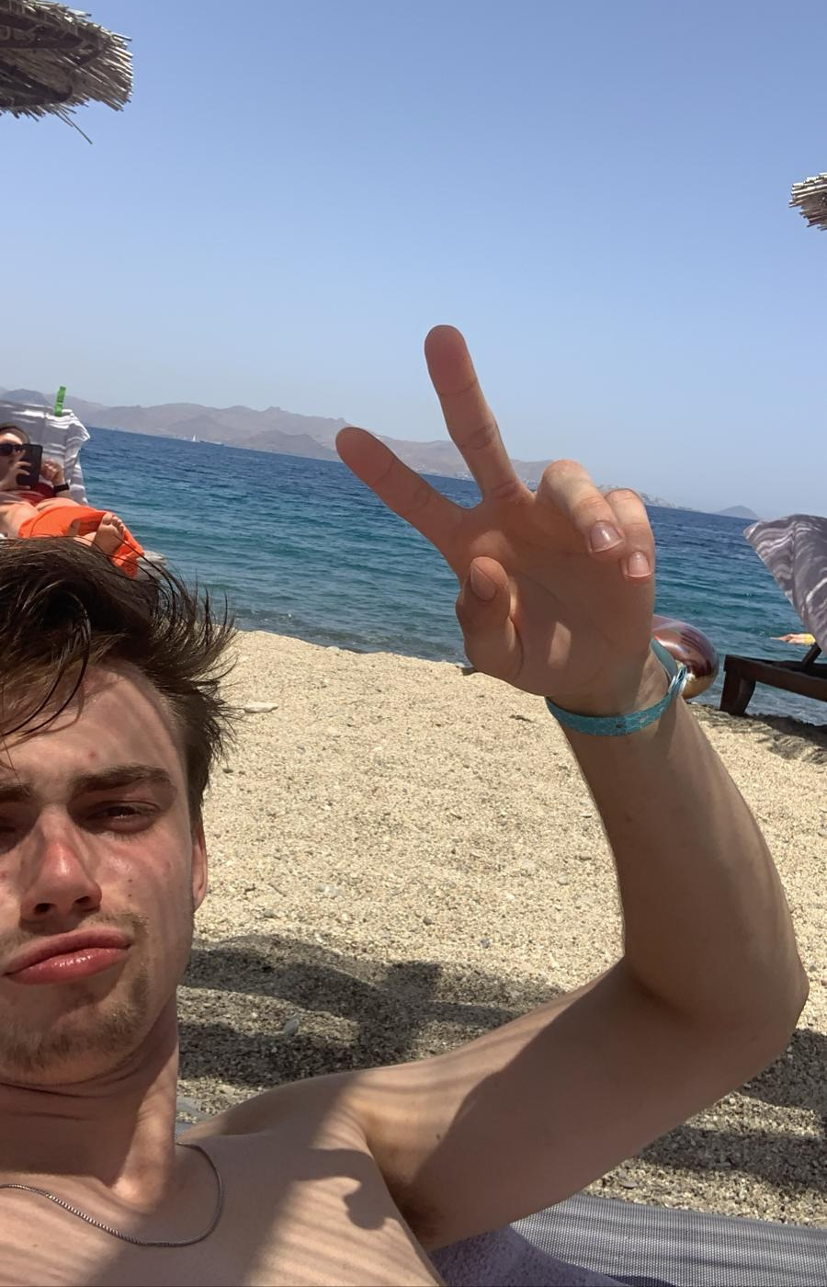
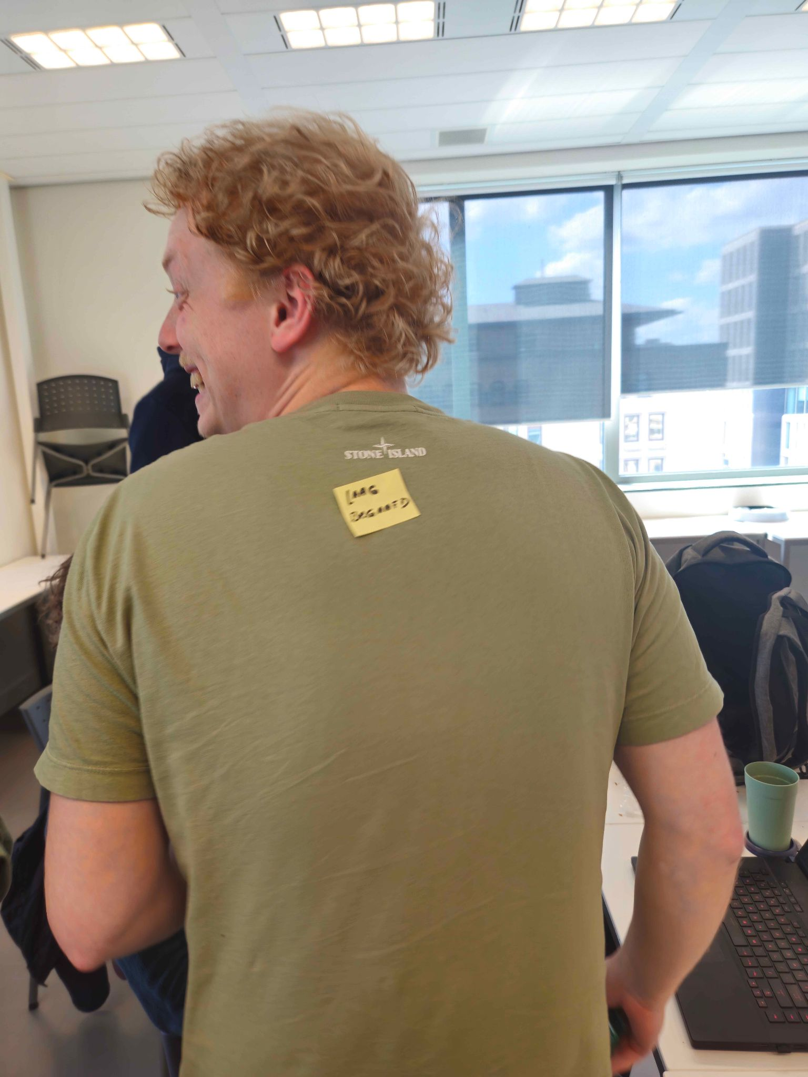
Bedankt voor het luisteren
Notes:
Gjalt

Slide 10
Vragen?
Notes:
Gjalt

